Slide 1


DataCo Online Sales Analysis
Data Visualization
Presented By -
KRISHNA AGRAWAL
Notes:
Manu / Krishna

Slide 2
TABLE OF CONTENTS
01
Explanation DataSet
02
Summary of Goal
03
KPIs
04
Dashboard Demo
05
Objectives Dashboard
06
Key skills
Notes:
Manu / Krishna

Slide 3
01
Explanation Dataset
Subject: Online Sales Data
The dataset chosen contains online sales data from DataCo Global.
The company is an online store, selling products across the main categories of clothing, sports, and electronic supplies.
They have international operations, receiving and delivering orders in 5 main markets: Africa , Europe , LATAM , Pacific Asia , USCA.
Dataset: Description & Data Cleaning/Transformation
The dataset contains 180,519 rows across 52 fields.
Main dimensions for fields can be grouped by: Sales Numbers, Order Information (Delivery Time, Geography), Customer Information, Product Information.
Data types include: Text, Date, Numeric, Currency, Boolean.
Data cleaning on countries field (erroneous naming for MAC users).
Data transformation to create column with the days difference between real delivery time - scheduled delivery time → This allows insight about the distribution of how many days orders were early/late.
Notes:
Manu / Krishna

Slide 4
02
What we want to achieve
The Sales director wants to have clear tracking of sales and insights regarding the different regions. The current practice of reporting is not goal-oriented & messy.
By next year, we want to increase our revenue by 10%
Increase Sales
Decrease Costs
Identify emerging/decreasing markets
Identify low selling product
Reduce delivery issues
Reduce frauds
Having a more equal distribution across different markets
Marketing promotion
Improve
Product
Counter the lack of resources
Optimize the inventory on specific product
Identify existing frauders
Identify method of frauding
Take legal actions
Prevent for future frauds
Notes:
Krishna

Slide 5
03
Goal-Driven KPIs
 | KPI 1: Grow Sales 10% per month YoY | KPI 2: Customer Satisfaction | KPI 3: Identify new markets | KPI 4: Reduce harmful impacts
Situation | Profit of $3.97 million → 11% of total sales | Late deliveries: 2015-2018 >54% p.a. Canceled orders >4% p.a. | Diverging sales performance across markets | Total loss due to fraud: $575k (14% of profit)
Causes | Need to identify markets or products that are low performing or causing losses | Lack of resources Inventory problems Logistical bottlenecks | Europe performing well Weak performance in: America; Central Asia | Malevolent actors are exploiting our services and committing fraud (Focus: Wire Transfer)
Actions | Tracking MoM% sales Launch marketing campaigns Improve product offering | Optimise logistics for delivery Apply targeted recruiting (seasonal workers) | Targeted new marketing campaigns Promotional campaigns | Identify processes Potential ML model to block transactions Take legal action
Notes:
Alice

Slide 6
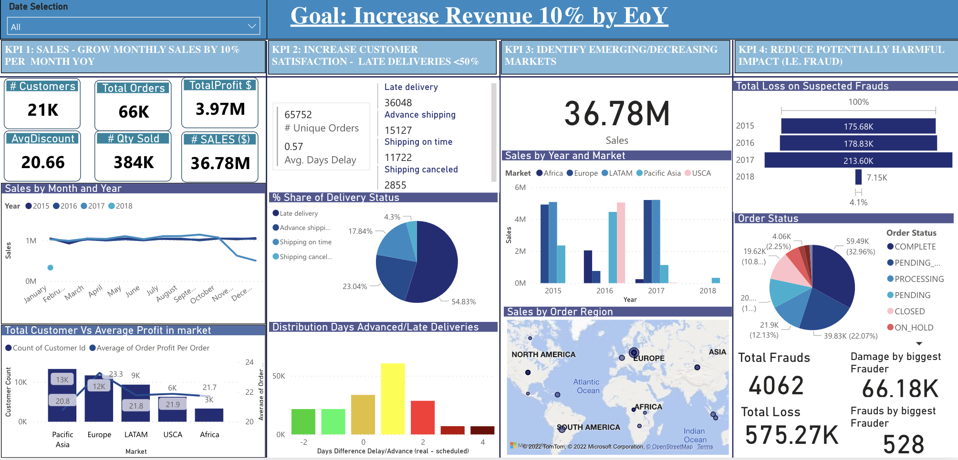
04
Dashboard Demo
https://app.powerbi.com/links/QvRKqPzSb8?ctid=73458443-1627-4091-8b39-2222134907c5&pbi_source=linkShare
Notes:
Thomas & Antoine

Slide 7
05
Objectives achieved or not
Goals Achieved
Sales KPI
- Highlighted products at profit/loss for the company to further improve it.
Customer Satisfaction
- Able to identify products and markets with maximum delays in the delivery to take further actions.
Identify Decreasing/emerging markets
- Identified markets that are not performing well to further improve their marketing campaigns.
Fraud detection
- Identified biggest frauders, countries where frauds are happening, total loss because of fraud, products on which fraudulent transactions happened.
Goals not achieved
Identify New Emerging markets
- To achieve the goal to enter new market, we lacked external data like competitors, consumer segmentations, purchasing behavior, environment analysis data, etc.
Fraud detection
- To identify the pattern to further avoid potential frauds, advanced Machine learning models are required.
Notes:
Juan / antoine

Slide 8
05
Objectives achieved or not
Most of the struggles with PowerBI were due to the fact that we couldn’t collaborate on the same dashboard, leading to the repetition of the same work multiple times over.
We had to do some extra data cleaning because the Mac version had problems reading some special characters of country names.
Due to our different backgrounds we didn’t have the same point of view of what was important for the business, which made the drawing up of the MECE chart a process of brainstorming & discussion.
We had to reshape and improve most of our visualisations in order to better point out our findings.
Notes:
Ali / Antoine

Slide 9
06
Skills
Members | Thomas | Alice | Krishna | Juan | Ali | Antoine | Manuel
Skills | • Creating Timeline & Heatmap on Power BI • Integrate advanced visualization functions | • Modeling data • Use the advanced features of the Power BI tool | • Cleaning and shaping Data • Creating an advanced report | • Cleaning and shaping Data • Use the advanced features of the Power BI tool | • Modeling data • Integrate advanced visualization functions | • Modeling data • Integrate advanced visualization functions | • Cleaning and shaping Data • Visualisation & Properties
Notes:
Juan / Antoine

Slide 10
Thank you for your attention!

